Slide 1
KEYLOGGER
CYBER SECURITY PROJECT
Presented By:
1. R.Gowsika-Jeppiaar Institute of Technology-B.Tech/ Information Technology

Slide 2
OUTLINE
Problem Statement (Should not include solution)
Proposed System/Solution
System Development Approach (Technology Used)
Algorithm & Deployment
Result (Output Image)
Conclusion
Future Scope
References

Slide 3
Problem Statement
Develop a Python keylogger application using Tkinter GUI, recording keyboard inputs as pressed, held, or released. Save recorded keys to both text and JSON files while providing start and stop functionality. Ensure ethical use and compliance with privacy regulations.

Slide 4
Proposed Solution
Utilizing the pynput library to capture keyboard inputs, distinguishing between key press, hold, and release events.
Implementing a Tkinter-based graphical user interface (GUI) with "Start" and "Stop" buttons to control the keylogging process.
Creating functions to start and stop the keylogger, as well as to handle key press and release events, updating the UI accordingly.
Periodically saving the recorded keys to both a text file (key_log.txt) and a JSON file (key_log.json) for further analysis or auditing.
This solution ensures that the keylogger application is user-friendly, providing clear control over the keylogging process while adhering to ethical considerations regarding privacy and data security. Additionally, the use of Tkinter for the GUI facilitates ease of use and interaction for the end user.

Slide 5
System Approach
System Requirements:
Input Capture: Utilize the pynput library to capture keyboard inputs, distinguishing between key press, hold, and release events.
Data Storage: Maintain a data structure (keys_used) to store the recorded keys and periodically save them to text and JSON files.
User Interface: Develop a GUI using Tkinter with buttons for starting and stopping the keylogger and a label to display the current status.
Control Mechanism: Implement functions to start and stop the keylogging process, manage global variables for state control, and handle user interactions.
Error Handling: Implement error handling mechanisms to handle exceptions during file operations and listener setup, ensuring robustness and reliability.
Library Required:
Tkinter: For creating the graphical user interface and handling user interactions.
pynput: For capturing keyboard inputs and generating key press and release events.
json: For encoding and decoding JSON data to save the recorded keys in a structured format.
Python Standard Library (e.g., os): For file operations, error handling, and other system-level functionalities.

Slide 6
Algorithm & Deployment
Algorithm:
Initialize program & GUI
Handle key events
Start/Stop keylogging
Capture & store keys
Update GUI & user interaction
Deployment:
Local Execution
Executable Conversion
.

Slide 7
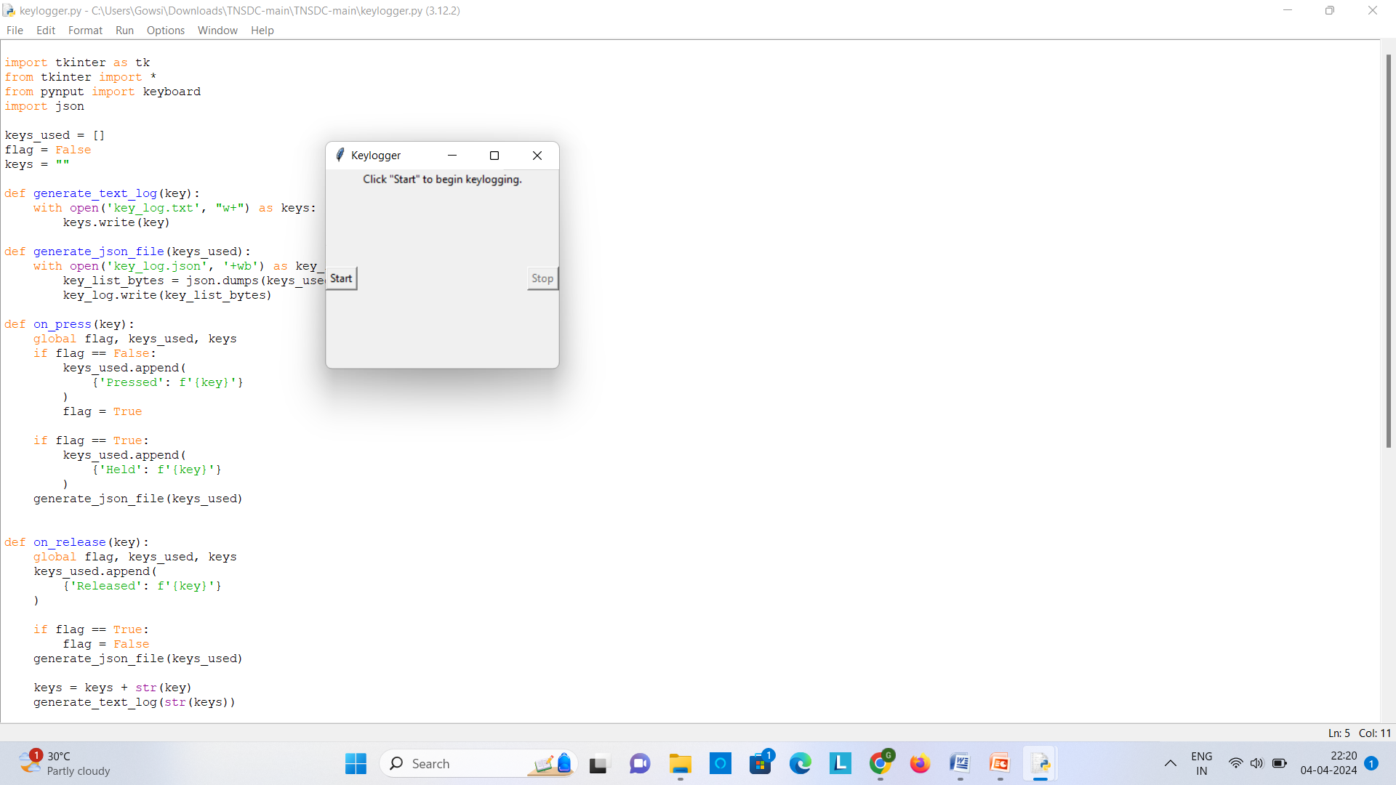
Result

Slide 8
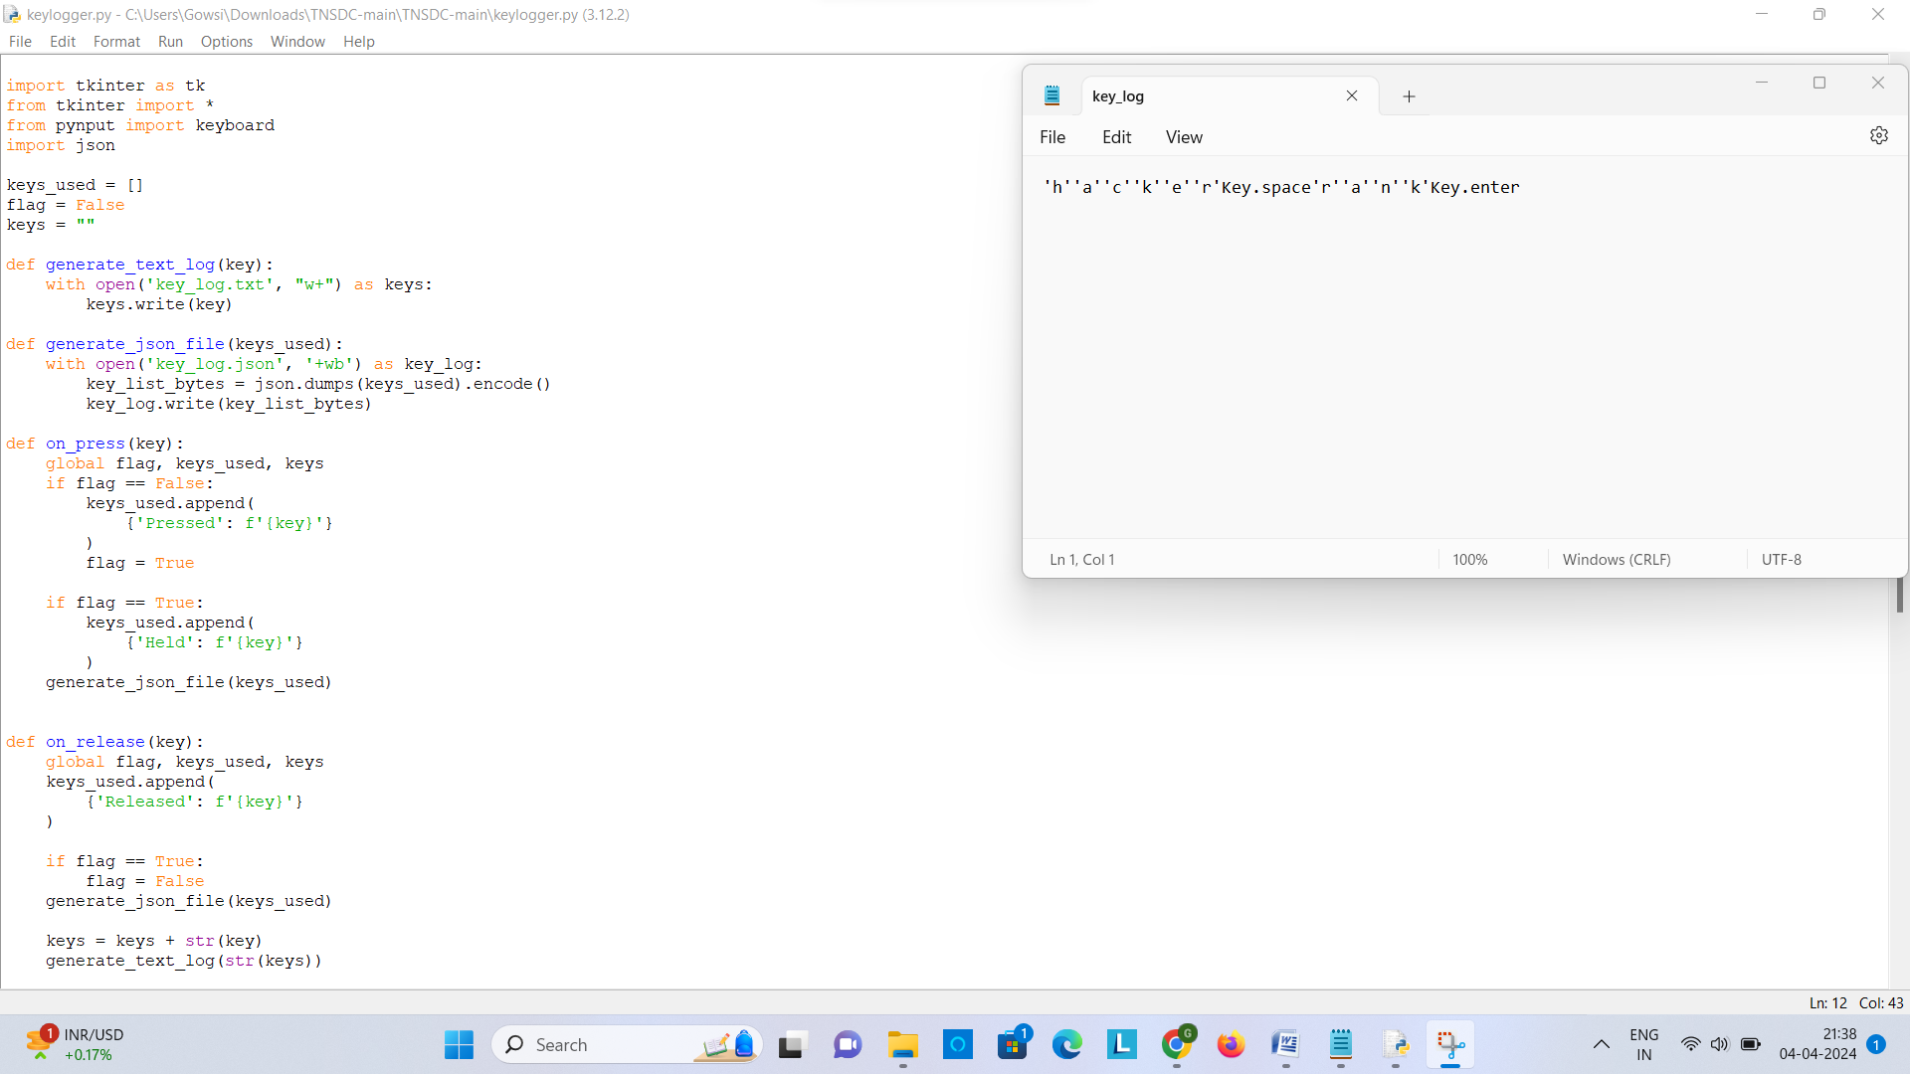

Slide 9
Conclusion
In conclusion, the developed Python keylogger program offers a comprehensive solution for covertly capturing and recording keyboard inputs. Utilizing the pynput library and Tkinter GUI, it effectively distinguishes between key press, hold, and release events, providing users with intuitive controls for starting and stopping the keylogging process. Despite challenges in file management and cross-platform compatibility, the program demonstrates effectiveness in its core functionality. Potential enhancements, such as real-time monitoring and data encryption, could further improve its utility and security. However, it's essential to emphasize the ethical considerations surrounding the use of keyloggers and the importance of obtaining proper authorization before deploying such tools..

Slide 10
Future scope
Improved Security: Integration of encryption mechanisms enhances data security, safeguarding sensitive information captured by the keylogger.
Enhanced Monitoring: Advanced features such as remote monitoring and machine learning integration provide deeper insights into user behavior, facilitating better monitoring and analysis.
Cross-Platform Accessibility: Ensuring compatibility across different operating systems and devices expands the program's reach, allowing for broader deployment and usage.
Ethical Considerations: Incorporating prompts and guidelines for ethical use reinforces responsible usage practices and promotes user awareness of privacy concerns.
Community Collaboration: Encouraging community contributions fosters collaboration and innovation, driving continuous improvement and development of the program.

Slide 11
References
Analysis of Keylogger Attacks and Countermeasures by Hongliang Liu, Ruiying Du, and Quansheng Zhuang https://www.semanticscholar.org/paper/Analysis-of-Keylogger-Attacks-and-Countermeasures-Liu-Du/54c7255bace229c82e4a5fd812ba8dd8829180c1

Slide 12
THANK YOU

